Slide 1
Ba 260: Lecture 12
Lecture 12:
Barringer Chapter 9

Slide 2
Ba 260: Lecture 12
New-Venture Team
Is the group of founders, key employees, and advisors that move a new venture from an idea to a fully functioning firm.
Usually, the team doesn’t come together all at once. Instead, it is built as the new firm can afford to hire additional personnel.
The team also involves more than paid employees.
Many firms have boards of directors, boards of advisors, and professionals on whom they rely for direction and advice.

Slide 3
Ba 260: Lecture 12
Liabilities of Newness
New ventures have a high propensity to fail.
The high failure rate is due in part to liabilities of newness, which refers to the fact that new companies often falter because the people involved can’t adjust fast enough to their new roles and because the firm lacks a track record of success.
Assembling a talented and experienced management team is one path that firms can take to overcome these limitations.

Slide 4
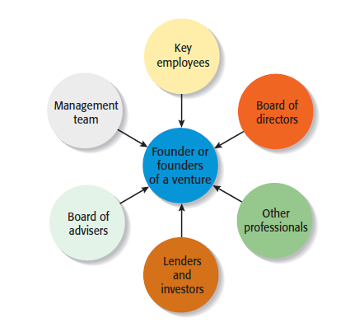
Ba 260: Lecture 12
Separate Elements of a New-Venture Team

Slide 5
Ba 260: Lecture 12
Founder or Founders
The characteristics of the founder or founders of a firm and their early decisions have a significant impact on the manner in which the new-venture team takes shape.
Size of the Founding Team
Studies have shown that 50% to 70% of all new ventures are started by more than one individual.
Experts disagree about whether new ventures started by a team have an advantage over those started by a sole entrepreneur.

Slide 6
Ba 260: Lecture 12
Advantages and Disadvantages of Starting a Venture as a Team
Advantages
Teams bring more talent, resources, and ideas to a new venture.
Teams bring a broader and deeper network of social and professional contacts to a new business.
The psychological support that the cofounders of a business can offer one another can be an important element of a new venture’s success.

Slide 7
Ba 260: Lecture 12
Advantages and Disadvantages of Starting a Venture as a Team
Disadvantages
Team members may not get along.
If two or more people start a firm as “equals,” conflicts can arise when the firm needs to establish a formal structure and designate one person as the CEO.
If the founders have similar areas of expertise, they may duplicate rather than complement one another.
Team members can easily disagree in terms of work habits, tolerances for risk, levels of passion for the business, ideas on how the business should be run, and similar key issues.

Slide 8

Ba 260: Lecture 12
Key Element of a Successful Founding Team
Heterogeneous rather than homogenous teams tend to be more effective.
This generic looking clipart picture from the book is a team is starting an educational software company.
The woman on the left is a former teacher, the woman in the middle is a software engineer, and the man on the right has a business background.

Slide 9
Ba 260: Lecture 12
Preferred Attributes of Sole Entrepreneurs and Members of a New-Venture Team
Higher Education
Evidence suggest that important entrepreneurial skills are enhanced through higher education
Prior Entrepreneurial Experience
Founders familiar with the entrepreneurial process are more likely to avoid costly mistakes than founders without similar experience.

Slide 10
Ba 260: Lecture 12
Factors that Contribute to a Founder or Founders’ Success
Relevant Industry Experience
Founders with relevant industry experience are more likely to have: Better established professional networks and more applicable marketing and management skills
Broad Social and Professional Network
Founders with broad social and professional networks have potential access to additional know-how, capital, and customer referrals.

Slide 11
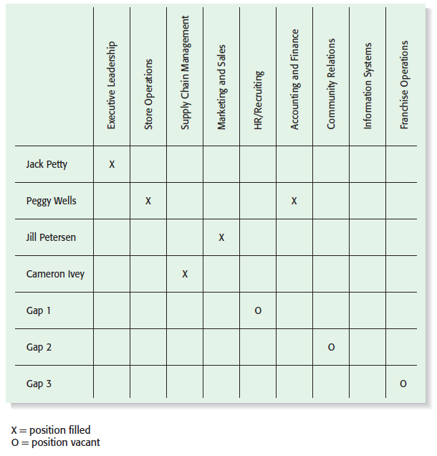
Ba 260: Lecture 12
Recruiting Key Employees
Start-ups vary in terms of how quickly they need to add personnel.
In some instances, the founders will work alone for a period of time. In other instances, employees are hired immediately.
A skills profile is a chart that depicts the most important skills that are needed and where skills gaps exist in a new firm.

Slide 12
Ba 260: Lecture 12
Board of Directors
If a new venture organizes as a corporation, it is legally required to have a board of directors.
A board of directors is a panel of individuals who are elected by a corporation’s shareholders to oversee the management of the firm.
A board is typically made up of both inside directors and outside directors.
An inside director is a person who is also an officer of the firm.
An outside director is someone who is not employed by the firm.

Slide 13
Ba 260: Lecture 12
The Roles of the Board of the Directors Formal Responsibility of the Board
A board of directors has three formal responsibilities.
Appoint the officers of the firm.
Declare dividends.
Oversee the affairs of the corporation.
Frequency of Meetings and Compensation
Most boards of directors meet three to four times a year.
New ventures are more likely to pay their board members in company stock or ask them to serve on a voluntary basis rather than pay a cash honorarium.

Slide 14
Ba 260: Lecture 12
What a Board of Directors Can Do to Help a Start-Up Get Off to a Good Start
Function
Importance of Function
Although a board of directors has formal governance responsibilities, its most useful role is to provide guidance and support to the firm’s managers.
Provide Guidance
Another function of a board of directors is to lend legitimacy to a firm. Well-known and respected board members bring instant credibility to a firm.
Lend Legitimacy

Slide 15
Ba 260: Lecture 12
Rounding out the Team: The Role of Professional Advisors
Board of Advisors
Lenders and Investors
Other Professionals

Slide 16
Ba 260: Lecture 12
Board of Advisors
A board of advisors is a panel of experts who are asked by a firm’s managers to provide counsel and advice on an ongoing basis.
Unlike a board of directors, an advisory board possesses no legal responsibility for the firm and gives nonbinding advice.
An advisory board can be established for general purposes or can be set up to address a specific issue or need.
Many people are more willing to serve on a company’s board of advisors than its board of directors because it requires less time and there is no potential legal liability involved.
Like the members of a board of directors, the members of a company’s board of advisors provide guidance and lend credibility to the firm.

Slide 17
Ba 260: Lecture 12
Guidelines to Organizing a Board of Advisors
Advisors will become disillusioned if they don’t play a meaningful role in the firm’s development and growth.
A firm should look for board members who are compatible and complement one another in terms of experience and expertise.
When inviting people to serve on its board of advisors, a company should carefully spell out to the individuals involved the rules in terms of access to confidential information.

Slide 18
Ba 260: Lecture 12
Lenders and Investors
Lenders and investors have a vested interest in the companies they finance, often causing them to become very involved in helping the firms they fund.
Like the other non-employee members of a firm’s new-venture team, lenders and investors help new firms by providing guidance and lending advice.
In addition, a firm’s lenders and investors assume the natural role of providing financial oversight.

Slide 19
Ba 260: Lecture 12
Ways Lenders and Investors Add Value to an Entrepreneurial Firm
Provide insight into the markets that the new venture plans to enter
Help identify and recruit key management personnel
Help the venture fine-tune its business model
Serve as a sounding board for new ideas
Serve on the new venture’s board of directors or board of advisors
Provide introductions to additional sources of capital

Slide 20
Ba 260: Lecture 12
Ways Lenders and Investors Add Value to an Entrepreneurial Firm
Help to arrange business partnerships
Recruit customers
Serve on the board of directors or board of advisors
Provide a sense of stability and calm

Slide 21
Ba 260: Lecture 12
Other Professionals
The other professionals that make up a firm’s new-venture team include attorneys, accountants, and business consultants.
Business Consultants
A business consultant is an individual who gives professional or expert advice.
Business consultants fall into two categories: paid consultants and consultants who are available for free or at a reduced rate through a nonprofit or governmental agency.

